Slide 1

The IG Assistance Function
Special Cases & Considerations
AR 20-1, Chapter 6, &
A&I Guide, Part One, Chapters 3 through 10

Slide 2
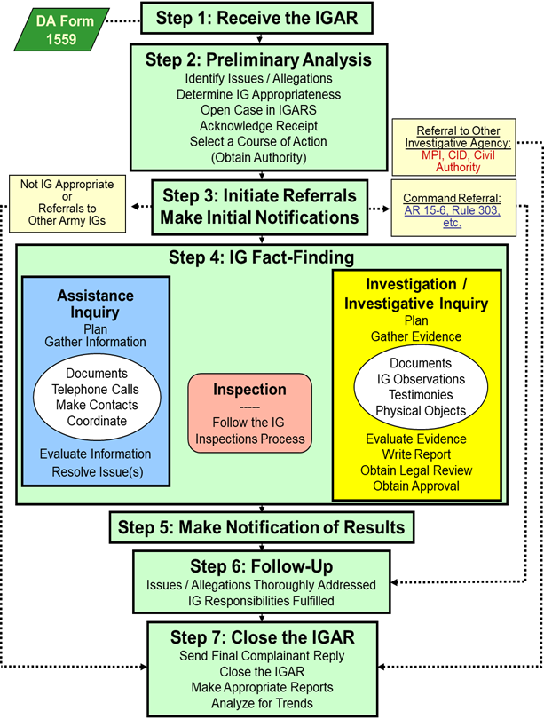
STEP 2 Determine IG Appropriateness
Step 2 Preliminary Analysis
Identify Issues / Allegations
Determine IG Appropriateness
Open Case in IGARS
Acknowledge Receipt
Select a Course of Action
(Obtain Authority)
Bottom Line:
Some complaints are not IG appropriate!

Slide 3
Not IG Appropriate
ELO
5
Non-Army-related issues (A&I Guide, Part One, Sect. 3-1-1)
EO complaints (with exception) (A&I Guide, Part One, Sect. 3-1-4)
Hazardous work conditions (A&I Guide, Part One, Sect. 3-1-7)
Redress available through other channels (A&I Guide, Part One, Sect. 3-1-2) (due-process)
Criminal allegations (with exception) (A&I Guide, Part One, Sect. 3-1-6)
Soldier non-support of Family (A&I Guide, Part One, Sect. 3-1-3)
Redress available to DoD civilians (A&I Guide, Part One, Chapter 7)
AR 20-1, para. 6-3

Slide 4

Not Local IG Appropriate Senior Official Allegations
Allegations against
  COL(P) and General Officer
  Senior Executive Service (SES) civilian
  Professor, USMA
Report to DAIG Investigations Div within 2 working days
Prior to an Information IGAR, contact Investigations Division, usarmy.pentagon.hqda-otig.mbx.saig-in-office@mail.mil
Do not name the senior official or complete a Standard IGAR!
Do NOT conduct ANY fact-finding
AR 20-1, para. 7-1l, 1-4b (5) (d)
A&I Guide, Part One, Sect. 3-2-1

Slide 5

Not Local IG Appropriate
Professional Allegations
Army lawyers (military or civilian) refer to DAIG’s Legal Advisor (AR 20-1, para. 7-1i (4)-(5))
IGs refer to next higher IG (AR 20-1, para. 7-1j)
Medical, CID Agents, Recruiters, Chaplains, etc. (A&I Guide, Part I, Sect. 3-2-3)
A&I Guide, Part One, Sect. 3-2-3

Slide 6

Not Local IG Appropriate
Intelligence Activities
Allegations against
  Members of Special-Access Programs (SAP)
  Members of Sensitive Activities (SA)
Report to DAIG’s Intelligence Oversight Division within 2 working days
AR 20-1, para. 1-4b (5) (e)
A&I Guide, Part One, Sect. 3-2-2

Slide 7
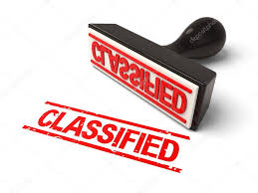
Intelligence Activities / Systems
IGARs Processing
Tech Channels: Unit SSO or DAIG’s Intelligence Oversight Division for IGARs involving:
  Questionable Intelligence Activities
  Above Unclassified level
    Verbal
    Supporting Documentation
    Spillage
  Non-Intelligence Activities in classified system / area
  Security Clearances

Slide 8
Family Non-support
NOT IG Appropriate
Regulation: AR 608-99, Family Support, Child Custody, and Parentage
Commander’s Responsibilities (AR 608-99):
  Determine information necessary to resolve issue
  Respond to complainant within reasonable time
  ... and much more
IG’s Responsibilities (AR 20-1, para. 6-3a):
  Ensure Family’s immediate needs are met
  Ensure Soldier’s commander is aware
  Do NOT retain bank information
  Do NOT become an advocate
ELO
6
ELO
7

Slide 9
Family Non-support
Make Your Job Easier
Teach and train on AR 608-99
  Company Commander and First Sergeant Course
  Officer Professional Development / Noncommissioned Officer Development Program
  Newcomer’s Orientation
  Pre-deployment Training / Briefings
Available resources
  Family Readiness Groups (FRG)
  Army Community Services (ACS)
  Army Emergency Relief (AER)
  Chaplain
  DEERS / ID Card Station
  Red Cross
  Local Churches, Food Shelters
  http://www.militaryonesource.mil/

Slide 10
Private Indebtedness
NOT IG Appropriate
Command issue (DODI 1344.09)
Know and adhere to state laws
IG’s role is to assist in properly routing the complaint
AR 20-1, para. 6-3b

Slide 11
Due Process Review
Due-Process review is IG appropriate … even if issue may not be IG appropriate or has another avenue of redress
  Complainant must first comply with prescribed redress process
    Redress Available through other means: AR 20-1, Section 6-3g
IG is limited to a review of the redress process to determine if the Solder was afforded the due process provided by law or regulation
Outcomes:
-There was no fault
- Complainant failed to comply
- Responsible official failed to comply
  AR 20-1, para. 6-1b. and 6-3g.
  A&I Guide, Part One, Section 4-1

Slide 12
Processing IGARs Not Appropriate for IGs
ELO
5
  Thoroughly analyze the complaint to identify all issues
  Determine if the complainant has attempted to use the appropriate appeal process or agency -- if not, advise him / her to do so
  Complete DA Form 1559 -- open & close case in IGARS database (unless classified)
  Look for possible systemic issues
AR 20-1, para. 6-3

Slide 13
Civilian IGARs

Slide 14
Civilian IGARs which are Usually NOT IG Appropriate
ELO
5
Grievances: Refer to Civilian Personnel Advisory Center (CPAC)
Appeals of Adverse Action: Refer to CPAC
Discrimination or Harassment Complaints: Refer to Equal Employment Opportunity (EEO)
Whistleblower Reprisal: Referral depends on status (more during investigations)
AR 20-1, para. 6-3h.
A&I Guide, Part One, Sections 6 & 7

Slide 15
Civilian IGARs which May Be IG Appropriate
Matters not directly affecting the employment situation or well-being of the individual:
  Third-party complaints
  Misconduct
  Mismanagement
AR 20-1, para. 6-3h
A&I Guide, Part One, Sect. 6-1

Slide 16
Civilian Cases
Always analyze entire IGAR to determine if IG action is necessary to correct regulatory violation or systemic problem
Where does the IG go for advice?
  Local Civilian Personnel Advisory Center / Civilian Personnel Operations Center http://cpol.army.mil/library/permiss/
  Staff Judge Advocate
  Equal Employment Opportunity
A&I Guide, Part One, Sect. 6-1

Slide 17
IG Decision Matrix for DoD Civilian Complaints
Receive IGAR and determine appropriateness *
Process complaints or allegations against a third party, reports of misconduct, mismanagement, or matters requiring command attention
Yes
No
Grievance
Yes
Refer complainant to local CPAC for information and assistance
No
Appeal an adverse action
Yes
Enter in
IGARS
& Close Case
No
Advise to contact EEO- do not work this action
EEO
Yes
No
Yes
Yes
Retaliation or Reprisal
Whistleblower
Advise to contact OSC or DoD IG
No
Enter in IGARS take no further action
A&I Guide, Part One, Sect. 7-2

Slide 18
Summary
ELO 5. Identify issues and allegations that are not appropriate for the IG, and describe how the IG must process those IGARs.
ELO 6. Describe the commander’s role in receiving and resolving non-support cases in accordance with AR 608-99.
ELO 7. Describe the IG’s role in receiving and resolving non-support cases in accordance with AR 20-1.

Slide 19
Miscellaneous
Issues

Slide 20

Request to Withdraw a Complaint
ELO
8
Ask:
  Why
  Punishment or reprisal
  Someone else working the issue
  Issue is resolved
Obtain a written or verbal withdrawal request
IG decides whether or not to continue
AR 20-1, para. 6-2e
A&I Guide, Part One, Sect. 4-2

Slide 21

Untimely IGARs
ELO
9
Timely Manner ~ Effective Resolution
A IGAR is “untimely" if:
  Date of awareness is more than one year ago
  “OR”
  The event occurred more than three years ago
AR 20-1, para. 6-1e
A&I Guide, Part One, Sect. 4-3

Slide 22
Timeliness
Complaint
Timely
UNTIMELY
Knowledge > 1 year
Event > 3 years
Work Case
Don't Work
(IG decision)
Event < 3 yrs = Local IG
IG thinks
matter
warrants
addressing?
Event 3-5 yrs = ACOM, ASCC, DRU IG
Event > 5 yrs = TIG
Close Case

Slide 23
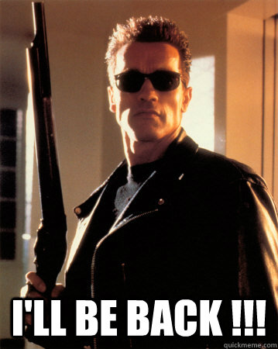
Habitual Complainants
“Pen / Phone Pals” “Super Email-er”
Analyze – Impartial, Unbiased, & Independent
  New, same information, or same case with new information
Always document in IGARS
Don’t ignore!
AR 20-1, para. 6-2b

Slide 24
Misusers of the IG System
Complainant’s responsibility to present truthful information
BUT if documented history of:
  Submitting baseless, unfounded complaints
  Pattern of presenting false, malicious, deceptive, or defamatory complaints
THEN the Command IG -- with Directing Authority’s approval -- may request that all future correspondence be in writing
Approval Authority is TIG (through DAIG Assistance Division)
AR 20-1, para. 6-2f
A&I Guide, Part One, Sect. 4-5

Slide 25
Morale Assessments
Great opportunity to Teach and Train directing authority on how to integrate moral assessments into organization
Assessing morale is a key aspect of an IG’s charter and a critical barometer for helping commanders determine their warfighting and overall mission readiness of their organizations
Morale vs. Command climate : Command Climate focuses primarily on leaders while morale focuses on the led.
  - IGs should be cautious conducting CC surveys since they must act on every issue/allegation that surfaces
Results (like trends) can be distributed on a CUI basis to subordinate commanders & staff as specified by the DA
  - Not used to compare leaders or Commanders
A&I Guide, Part One, Chapter 5

Slide 26
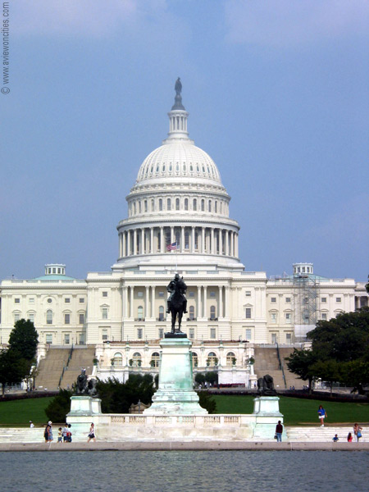
Congressionals
Just Another Way to Write-In

Slide 27
Congressional Correspondence Flowchart:
Command Channels
Complainant’s Letter to Member of Congress (MC)
MC Office
Office of the Chief of Legislative Liaison (OCLL)
Command Channels
Command Channels
Fort Von Steuben
Congressional Inquiries Office
A&I Guide, Part One, Sect. 8-1
27

Slide 28
Congressional Correspondence Flowchart:
IG Channels
Complainant’s Letter to Member of Congress (MC)
MC Office
Office of the Chief of Legislative Liaison (OCLL)
DAIG Assist Div
OoR
IG Channels
OoI
Fort Von Steuben
Inspector General Office
AR 20-1 para. 6-1f (1) and
A&I Guide, Part One, Sect. 8-2
OoI
28

Slide 29
Congressional Correspondence Flowchart:
National
Guard IG
(Federal Matters)
Complainant’s Letter to Member of Congress (MC)
MC Office
Office of the Chief of Legislative Liaison (OCLL)
DAIG Assist Div
OoR
NGB IG
OoI
State IG Office
AR 20-1 para. 6-1f (1) and
A&I Guide, Part One, Sect. 8-2
OoI
29

Slide 30
Congressional Correspondence Flowchart:
National
Guard IG
(State Matters)
Complainant’s Letter to Member of Congress (MC)
MC Office
State IG Office
AR 20-1 para. 6-1f (1) and
A&I Guide, Part One, Sect. 8-1
30

Slide 31
Coordination -- How to Prevent Duplication of Work
During a complainant’s interview (Step 1), the complainant tells the IG he or she wrote to their Member of Congress
DAIG’s Assistance Division refers a Congressional Inquiry to the local IG currently working or already completed and closed the case
Local IG actions:
  Coordinate / verify status of Congressional Inquiry with DAIG and OCLL
  Inform complainant final response will come from their Member of Congress
AR 20-1 para. 6-1f (1) and
A&I Guide, Part One, Chapter 8

Slide 32
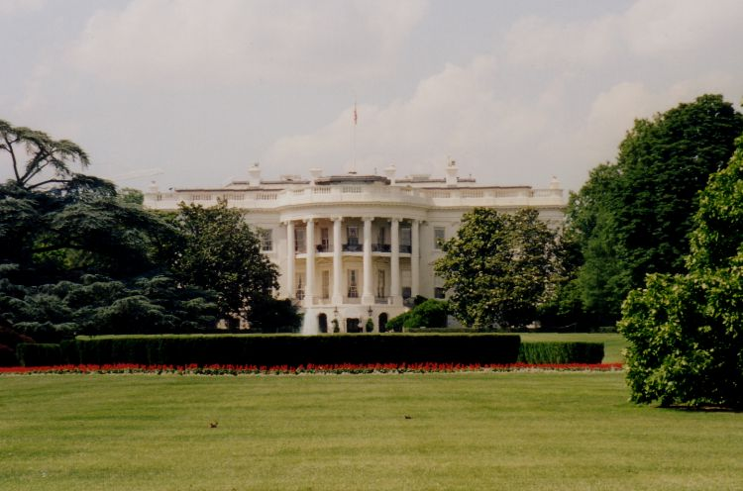
White House
(Presidentials)
Yet Another Way Complainants Write-In

Slide 33
White House Correspondence Flowchart:
IG Channels
Complainant’s Letter to President (or email to www.whitehouse.gov)
White House Liaison Office
Complainant
DAIG Assist Div
OoR
IG Channels
OoI
Fort Von Steuben
IG Office
OoI
A&I Guide, Part One, Chapter 9
33

Slide 34


Department of Defense Hotline
DoDI 7050.01
AR 20-1, para. 6-1f (3), para. 7-3a
A&I Guide, Part One, Chapter 10

Slide 35
DoD Hotline Cases
DoD
ER
DoD
HCR
DoD IG decides:
  Action vs. Information Cases
  DAIG vs. CID (criminal)
DoD program -- different formats MUST be used
Call DAIG Assistance Division – DoD Hotline Branch (703) 545-1845
  Extension Request (ER)
  Hotline Completion Report (HCR)
DoDI 7050.01
AR 20-1, para. 6-1f (3), para. 7-3a
A&I Guide, Part One, Chapter 10

Slide 36
Unique to DoD Hotline Cases
DoD Hotline referral is releasable "to persons with the need to know for the purpose of providing a response to the DoD IG”
Timeliness rules do not apply
The local IG will not make the final acknowledgment to the complainant
Very few areas are "not IG appropriate" when referred by DoD

Slide 37
DoD Hotline
Case (Action) Flowchart:
IG Channels
Complainant contacts DoD Hotline
DoD Hotline
DAIG Assist Div
Complainant completes FOIA request through DoD IG for answer
OoR
IG Channels
OoI
Fort Von Steuben
IG Office
DoDI 7050.01
AR 20-1, para. 6-1f (3), para. 7-3a
A&I Guide, Part One, Chapter 10
OoI
37

Slide 38
DoD Hotline
Case (Information) Flowchart:
IG Channels
Complainant contacts DoD Hotline
DoD Hotline
DAIG Assist Div
If Assistance Inquiry or Investigation results in "F" or "S", the Case converts to an Action Case. DAIG becomes OoR.
IG Channels
Fort Von Steuben
IG Office
DoDI 7050.01
AR 20-1, para. 6-1f (3), para. 7-3a
A&I Guide, Part One, Chapter 10
OoR
38

Slide 39
Summary
ELO 8. Describe the actions an IG should take when a complainant withdraws a complaint.
ELO 9. Describe what constitutes an untimely IGAR and the procedures for processing an untimely IGAR.

Slide 40
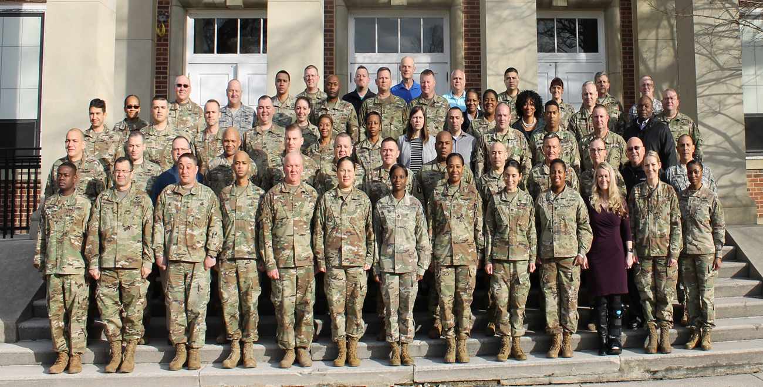
Questions?
Not IG appropriate topics
Family Non-support
Civilian IGARS
Withdrawn Complaints
Untimely Complaints
Office of Record / Inquiry
Congressional, etc.

Slide 41
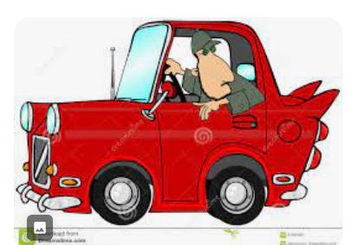
Back-Up Slides

Slide 42
Civilian Employee Categories
Appropriated Fund (APF)
  Governed by Office of Personnel Management (OPM)
Nonappropriated Fund (NAF)
  AR 215-3, NAF Personnel Policies and Procedures
  AR 20-1, para. 6-3c and e
  A&I Guide, Part One, Section 7

Slide 43
Civilian Employee
Categories
(continued)
Local Nationals (LN)
  Status of Forces Agreement (SOFA)
Contractors
  Statement of work determines avenue of redress
  Check with Contracting Officer or Contracting Officer Representative (COR)
  Check with the SJA
  AR 20-1, para. 6-3c and e
  A&I Guide, Part One, Section 7

Slide 44
Untimely IGARs
(continued)
For an untimely IGAR, the local IG will:
Local IG will:
  Complete a DA Form 1559
  Open case in IGARS ( Information IGAR for senior official involvement, no names )
  Analyze for all issues / allegations (PA)
  Inform complainant that the IGAR is untimely (case notes)
  Decide whether or not to work
  Close case in IGARS
Except . . .
AR 20-1, para. 6-1e
A&I Guide, Part One, Sect. 4-3

Slide 45
Untimely IGARs
(continued)
Exception:
If the event occurred between 3-5 years ago and ...
  Complainant insists
  Special Army interest
IG will:
  Complete a DA Form 1559
  Open case in IGARS (Information IGAR for senior official involvement)
  Analyze for all issues / allegations (PA)
  Inform complainant that the IGAR is untimely (case notes)
  Forward for Army Command (ACOM), Army Service Component Command (ASCC), or Direct Reporting Unit (DRU) IG to decide whether or not to work the case
  Close case in IGARS
AR 20-1, para. 6-1e
A&I Guide, Part One, Sect. 4-3

Slide 46
Untimely IGARs
(continued)
Exception:
If the event occurred more than 5 years ago and ...
  Complainant insists
  Special Army interest
IG will:
  Complete a DA Form 1559
  Open case in IGARS (Information IGAR for senior official involvement)
  Analyze for all issues / allegations (PA)
  Inform complainant IGAR is untimely (case notes)
  Forward to TIG (SAIG-AC) to decide if IG will work the case or if other action is necessary.
  Close case in IGARS
AR 20-1, para. 6-1e
A&I Guide, Part One, Sect. 4-3

Slide 47
Untimely IGARs
Examples
Date of Event | Complainant Aware | Date to IG | Timeliness
10 Jan 00 | 11 Mar 01 | 1 Apr 01 | Timely
10 Jan 00 | 11 Mar 01 | 1 Apr 02 | Untimely (Local IG decides)
10 Jan 00 | 11 Mar 03 | 1 Apr 03 | Untimely (ASCC, DRU, ACOM IG decides)
10 Jan 00 | 11 Mar 00 | 1 Apr 05 | Untimely (TIG decides)
Less than one year
More than one year
More than three years
More than five years
AR 20-1, para. 6-1e
A&I Guide, Part One, Sect. 4-3

Slide 48
Hotline Completion Report
The Local IG will follow the Inspector General Action Process as outlined in The Assistance and Investigations Guide.
The format of the report submitted to DoD is different from the Report of Investigation / Investigative Inquiry.
DoDIG is the final approval authority for all cases originating in their office.
A&I Guide, Part One, Chapter 10
A&I Guide, Part Two, Chapter 10

